Slide 1

Oxcitas Challenge
By jon perez

Slide 2
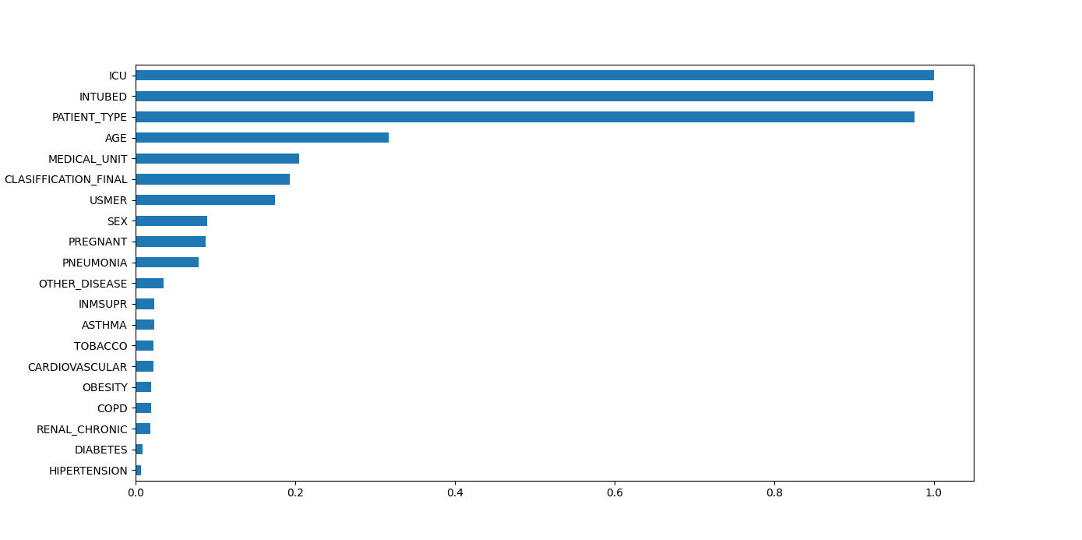
The Data
Problems with the data:
Considerable amount of missing data (97% in the ICU column ).
Data conflicts with medical consultations
Considerable amount of cases where person is intubed but not in the ICU.
Age distribution is dubious since it goes to 0 up to 121 (The longest living person now 115, ever 122)
Data is poorly correlated:

Slide 3
Data Pre-processing
Target variable:
A target variable was created collecting ICU and date died.
If date died or ICU is 1, target = 1
If not date died but ICU is 2, target = 0
If no date died and ICU missing, target = -1
Boolean variables where adapted to 0-1 instead of 2-1
DATE_DIED was adapted to a Boolean field
Imputed missing pregnancy values for males as 0
Train and test split is done in an stratified fashion leaving out rows when the target was missing

Slide 4
Machine Learning approach
Numerical processing pipeline:
Imputing: KNN Imputer
Scaling: Robust Scaler
Normalization: Power Transformer
Categorical/Boolean pipeline:
Imputing: KNN Imputer
Given the extent of Categorical data a series of tree models was tested
The best performing model for the AUC ROC metric is saved with the processing pipelines

Slide 5
Deep Learning approach
Define a Multi Layer Perceptron:
Activation: ReLu
Dropout: 0.2 - 0.4
Output layer: Sigmoid
Other factors:
Optimizer: Adam with a step LR scheduler
Criterion: BCE
100 Epochs
Three models are saved:
Best performer in terms of loss
Best performer in terms of accuracy
Best performer in the AUC ROC metric

Slide 6
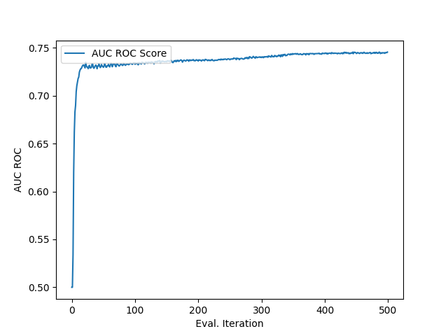
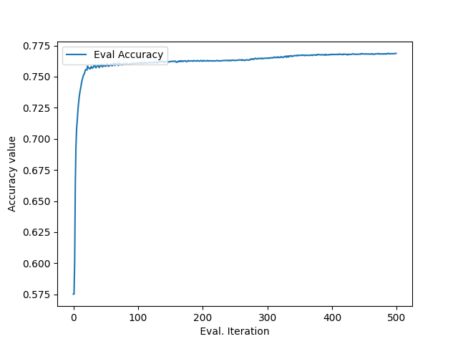
Final Results
From the tree classifiers we find similar performances from the top 5 models:
The MLP performer similarly
The MLP performer similarly:
Rank | Model | AUC | Accuracy | Bal Acc. | Time
1 | Skl HistGBM | 75.485562 | 77.401186 | 75.485562 | 1289.978809
2 | LightGBM | 75.484398 | 77.40863 | 75.484398 | 1049.338019
3 | CatBoost | 75.465103 | 77.341637 | 75.465103 | 1020.509089
4 | XGBoost | 75.423438 | 77.26472 | 75.423438 | 985.761059
5 | Skl GBM | 75.133448 | 77.205171 | 75.133448 | 1307.375644
6 | AdaBoost | 74.416915 | 76.701486 | 74.416915 | 937.752481
7 | Random Forest | 72.305331 | 73.607424 | 72.305331 | 1223.647592
8 | Extra Trees | 71.450414 | 72.979679 | 71.450414 | 924.779041
9 | Decision | 70.301888 | 71.878024 | 70.301888 | 876.550204

Slide 7
Conclusion
Given the quantity of missing data in target variables and the poor correlation between the variables and the target there was an effective cap on the models performance.
On top of that the amount of Boolean variables meant that there where not that many combinations of them. Paired with the poor correlation this significantly increased the noise in the data

